Slide 1
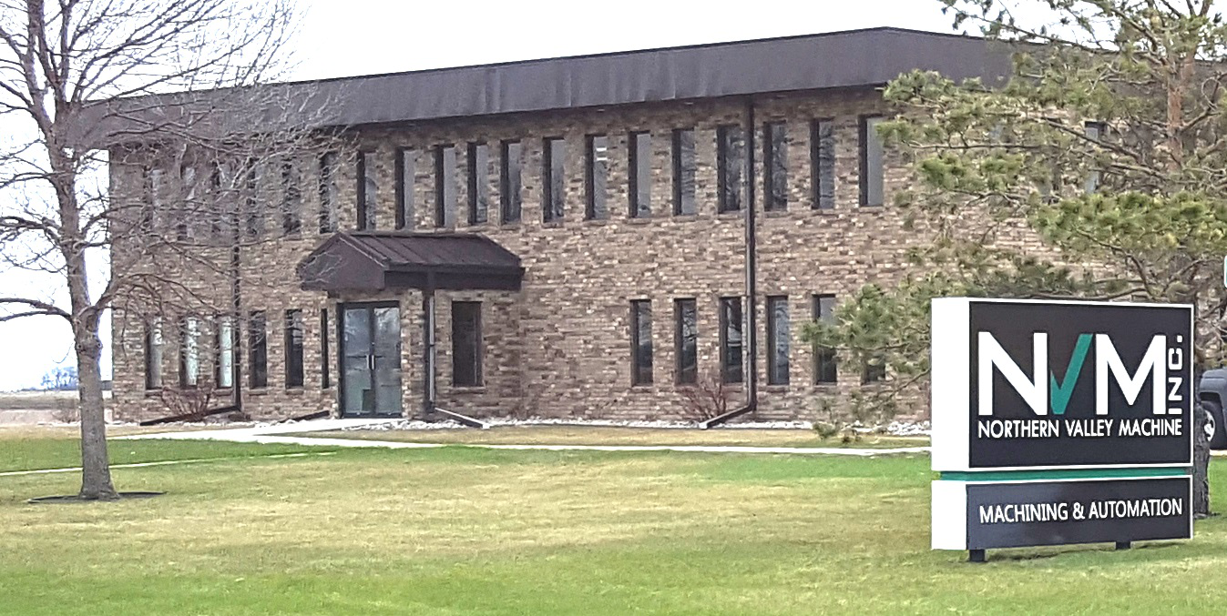
Capabilities and Projects

Slide 2
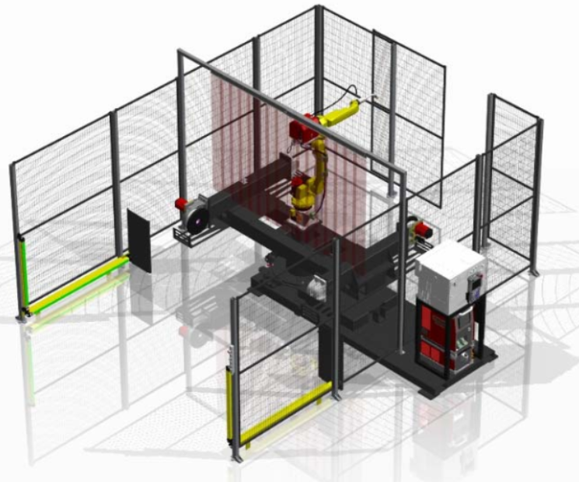
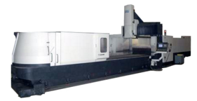
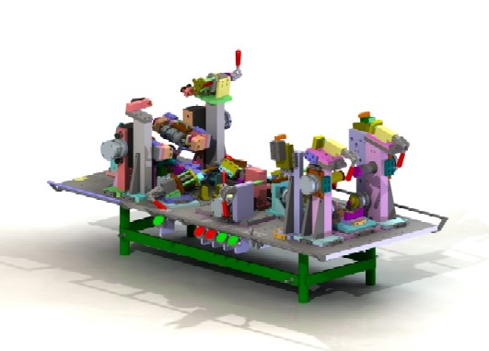
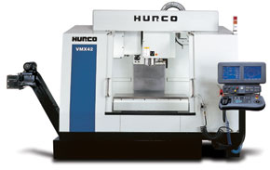
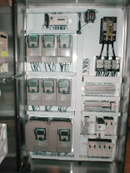
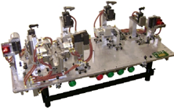

Background
Founded in 1992
Located in East Grand Forks, Minnesota
Approximately 60,000 sq ft
70 employees
UL 508A Listed Panel Shop (File #E251126)
In-house Electrical and Mechanical Engineering
Quality Assurance Department
Fully Staffed Electrical and Mechanical Assembly

Slide 3




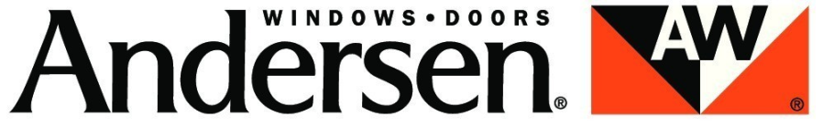

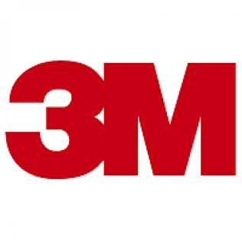










Customers
Industries Served:
  Aerospace Equipment Manufacturing
  Window Manufacturing
  Recreational Vehicle Manufacturing
  Agriculture Equipment Manufacturing
  Material Handling
  Packaging

Slide 4
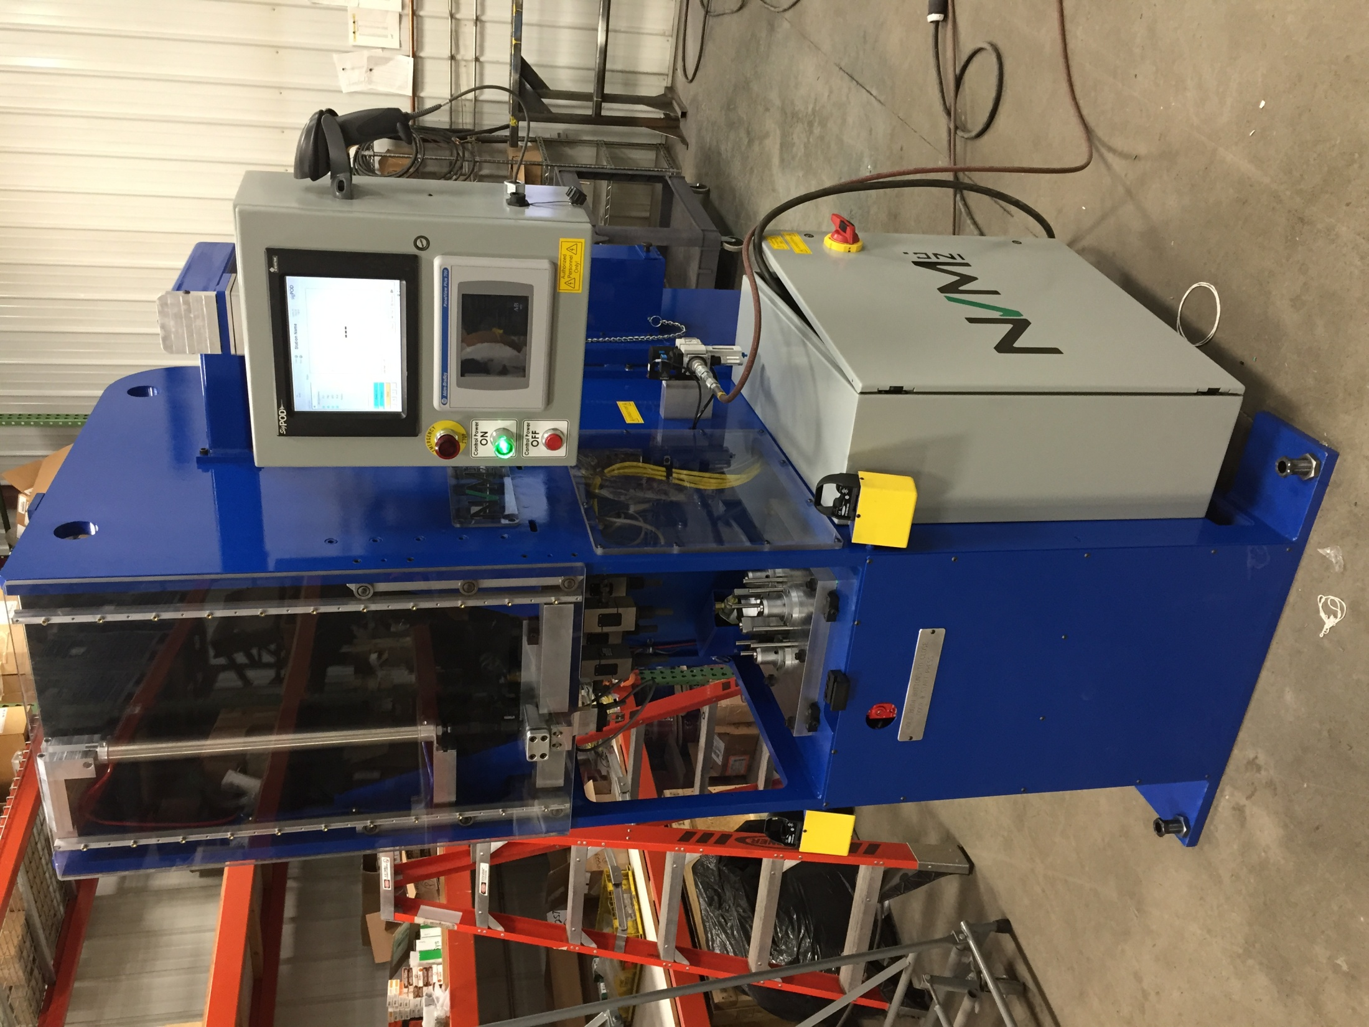
Automation Capabilities
Automated Equipment
Component Processing Equipment
  Automatic Saws
  Automatic Drilling Machines
  Automatic Drilling and Grinding Machine
  Automated Punch Press
  Drill and Notch Machine
  Ergonomic Lift Assist

Slide 5
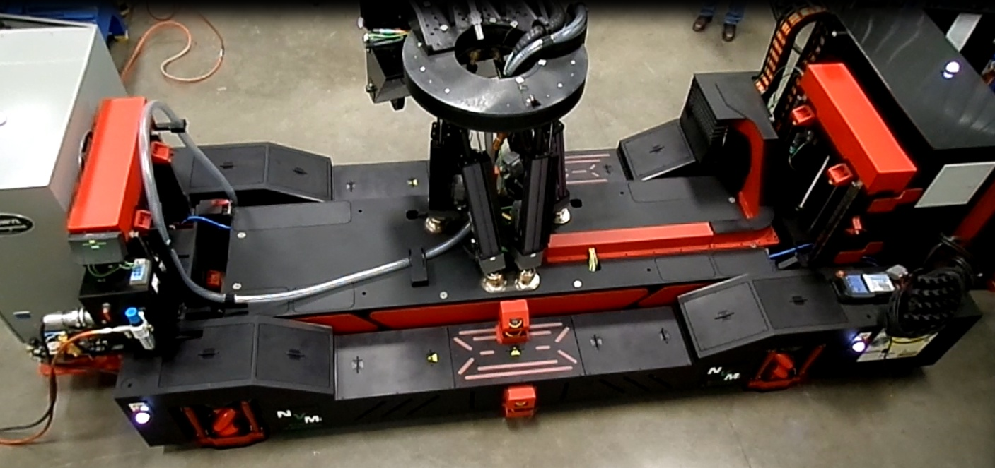
Automation
Mobile Robotic Drilling and Fastening System
For this project the customer provided a full design of the machine. Northern Valley Machine reviewed the mechanical and electrical design with our engineers and built the machine to print with some minor changes.
Northern Valley Machine Responsibility
Redesign parts so they can be manufactured
Machine all parts and weldments
Assemble all parts
Assemble electrical panels

Slide 6
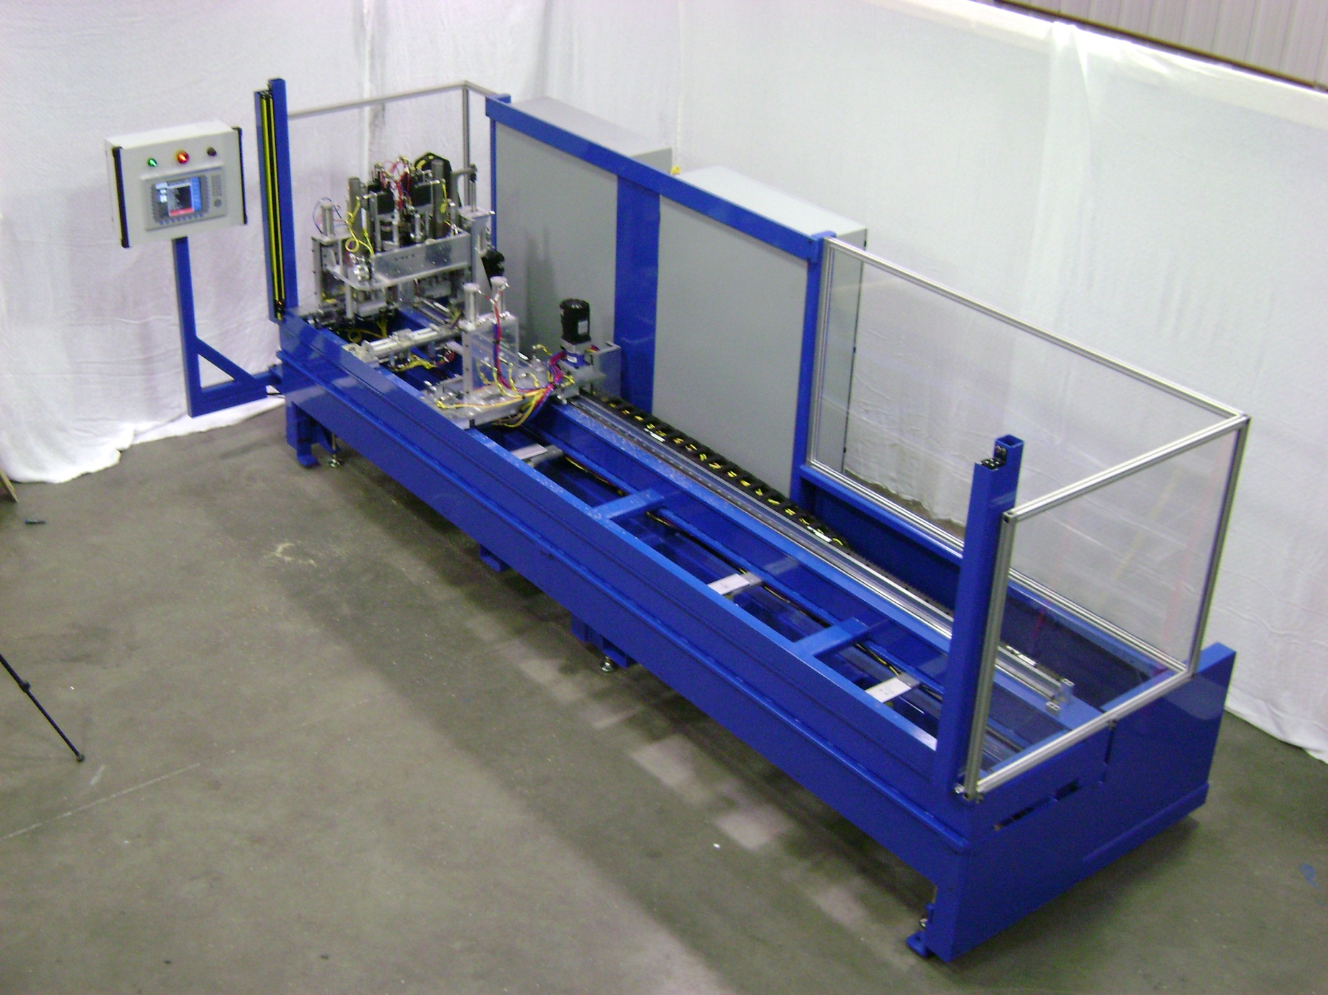
Automation Capabilities
Automated Equip. – Automatic Drilling – Variable Hole Location
Part Lengths 24”-144”
Infinite Part Lengths
Length Verified before Drilling
Custom code developed for each length
Positional accuracy within 0.002”

Slide 7
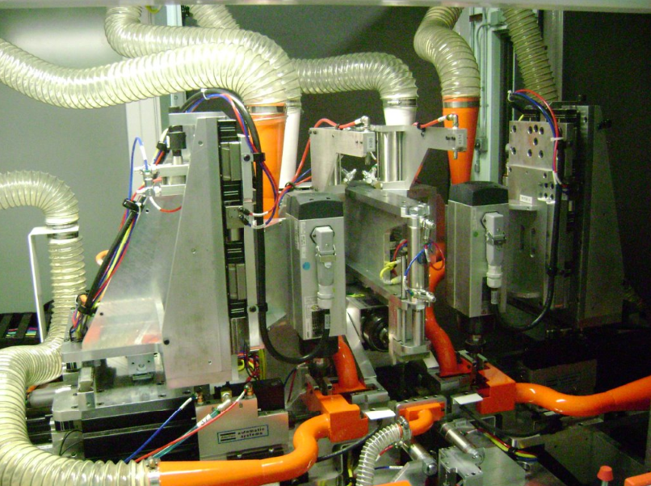
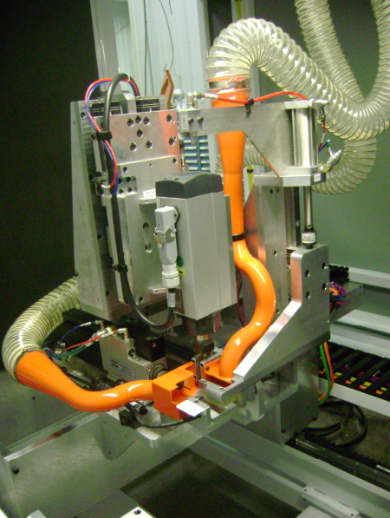
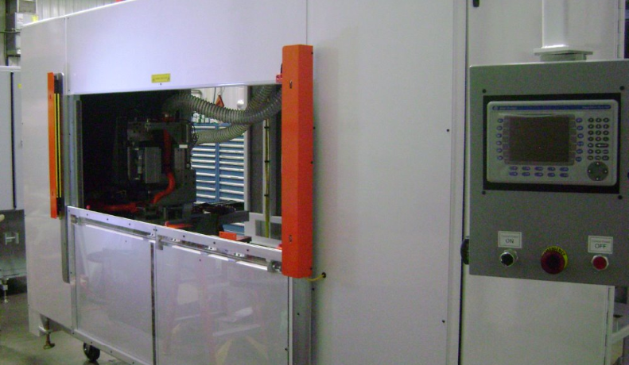
Automation Capabilities
Automated Equip. – Component Fabrication Machine
Machine wood parts for a window sash
9 different fabrication operations
Servo controlled coordinated motion

Slide 8
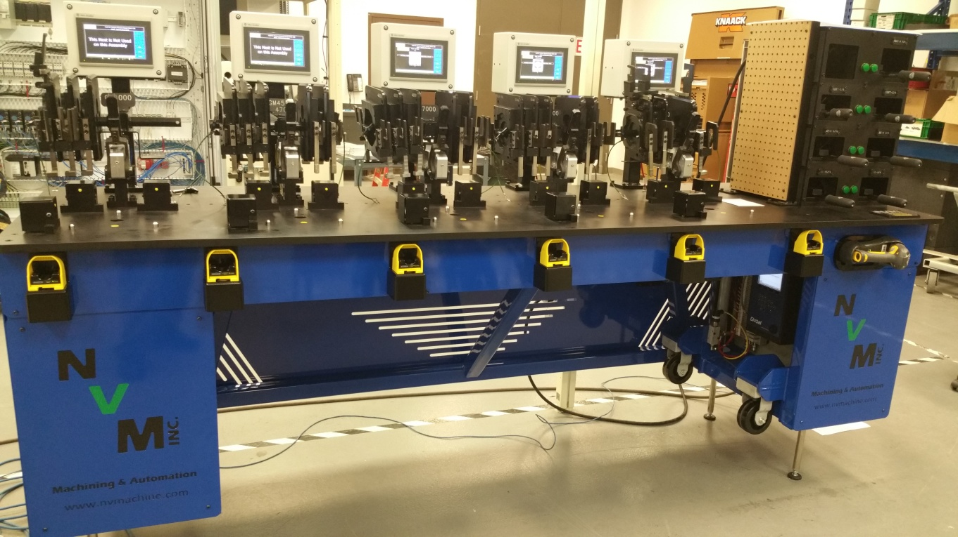
Smart Assembly Stations
RFID technology to verify correct adaptor
Logging
  Torque
  Time/Date
  Model
  Serial Number
HMI walks operator thru assembly for each station
Clocking Arms for fittings
Smart torque wrench tool holder
Adjustable Height
Notes:
This project the customer was having issues with their assemblers not torquing every fitting on a hydraulic motor. The other issue was the fittings were not put on at the right angle so they would be loosened and retightened on the assembly line.

Slide 9
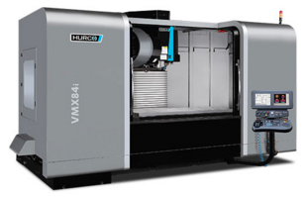
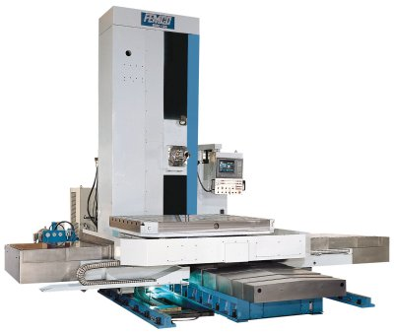
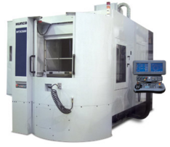
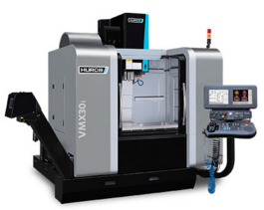
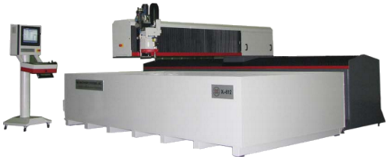
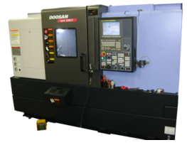
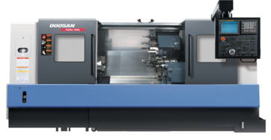
Machining
2 shifts of production
Short Term to Long Term production
Prototype Machining
Gibbs CAM software
5 Axis CNC Mill
10 Vertical CNC Mills
2 Horizontal CNC Mills
1 Waterjet
2 Bridge Mills
2 Boring Mill
4 CNC Lathes
2 EDM Machines
3 Grinders

Slide 10
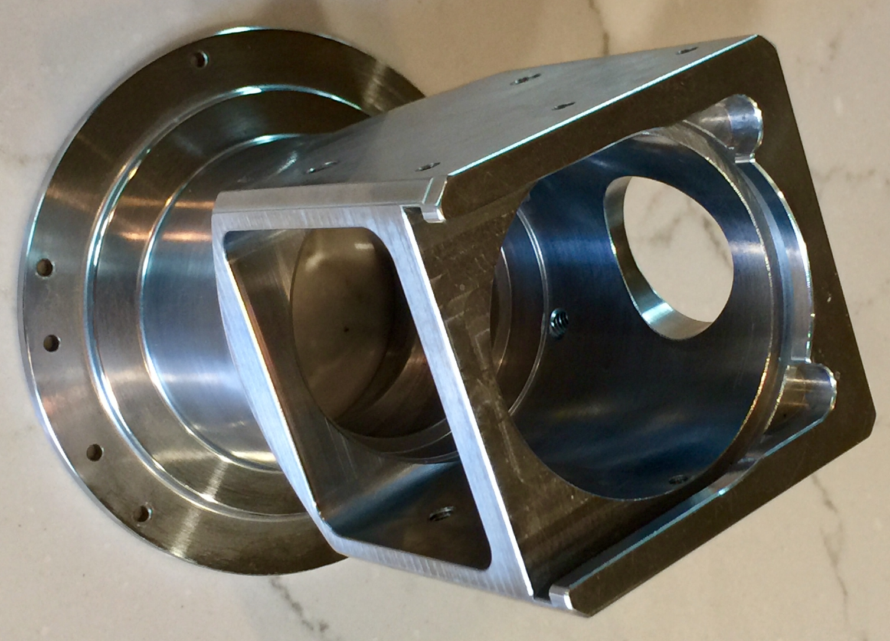
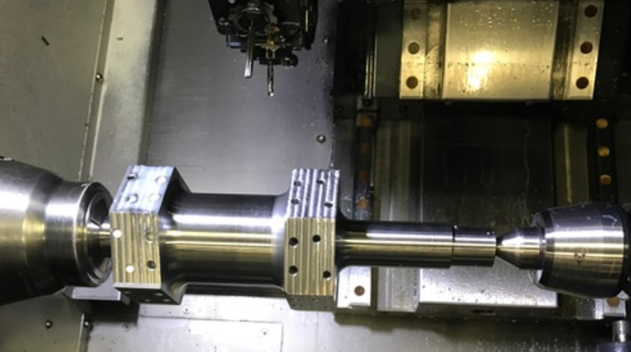
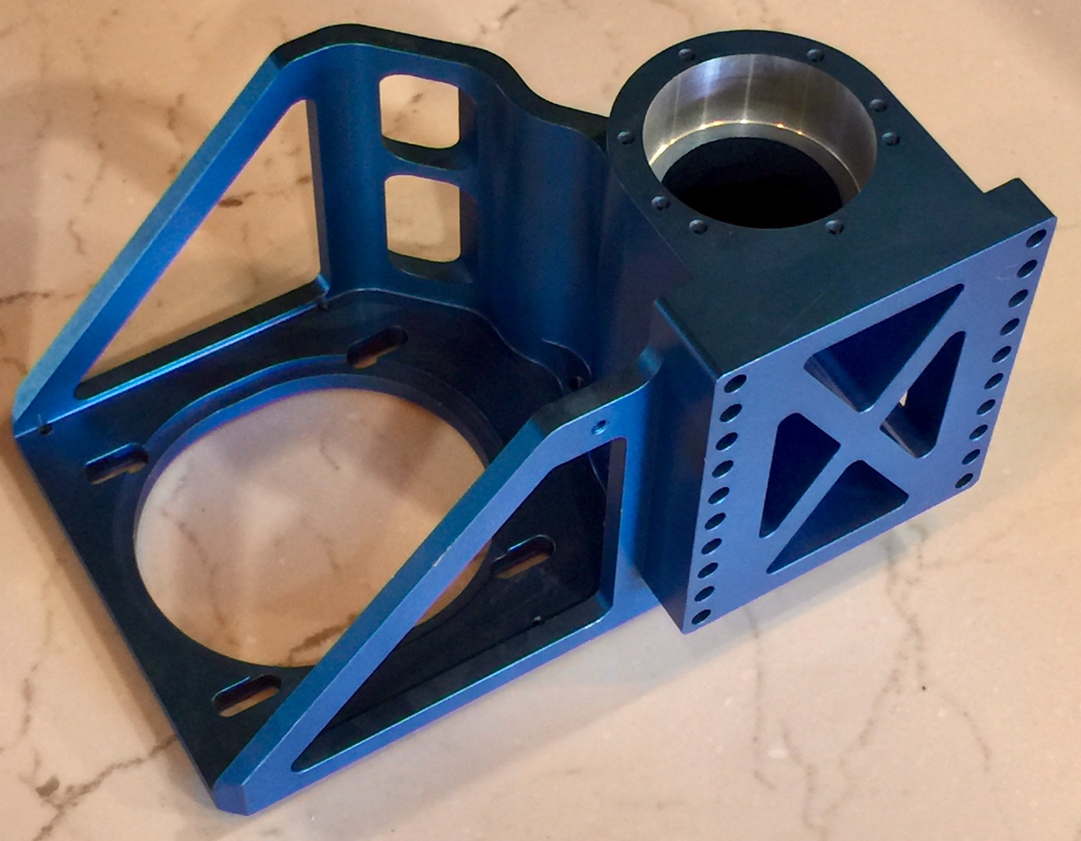
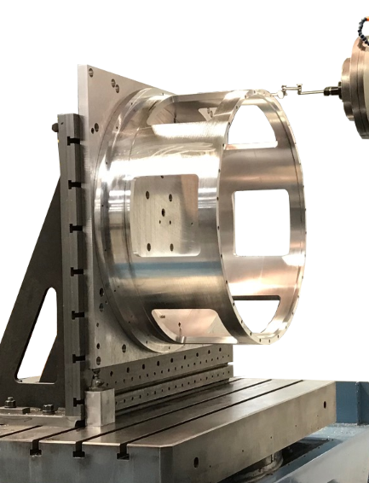
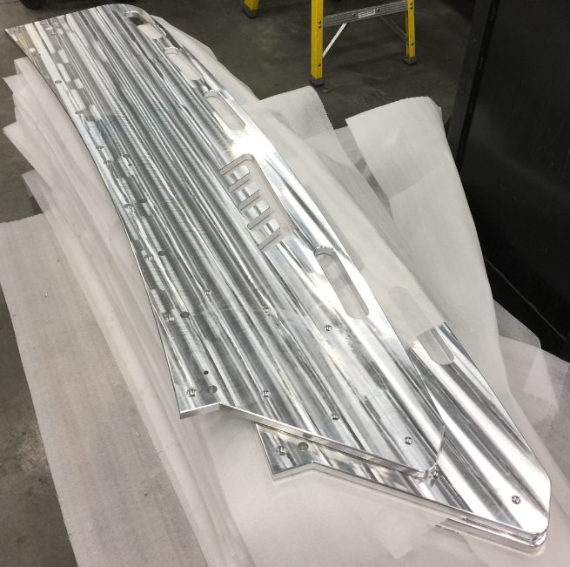
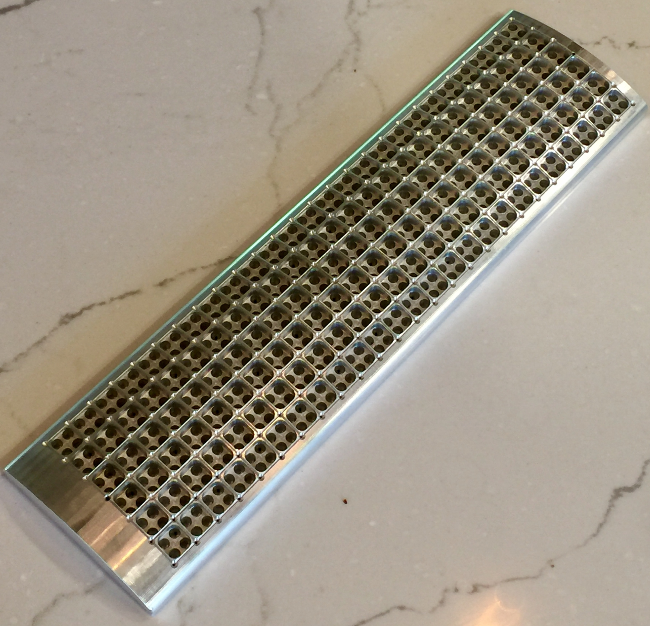
Machining
Machining Examples

Slide 11
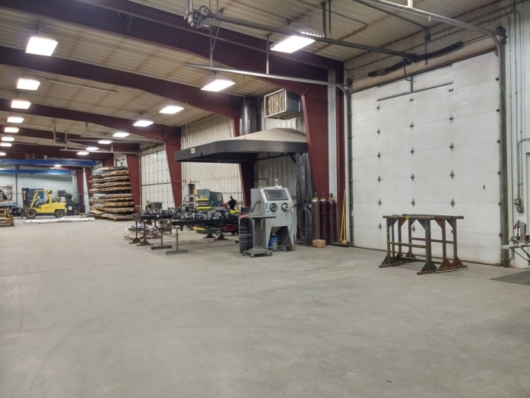
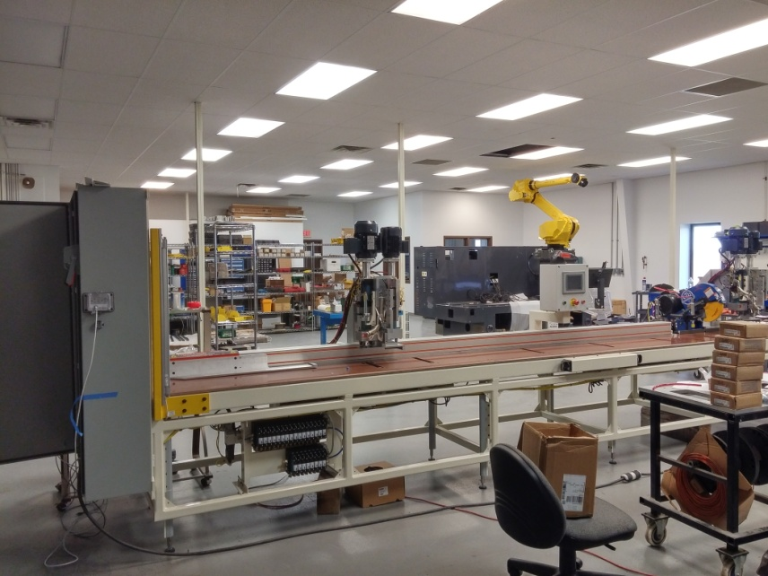
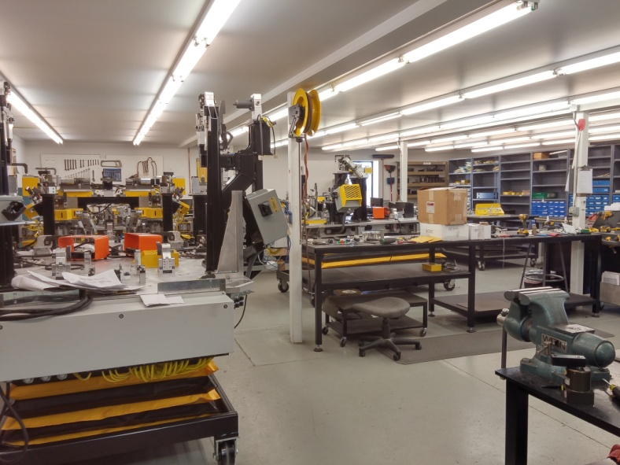
Assembly
Assembly Capabilities
Separate electrical and mechanical assembly rooms
Secure key card access to assembly areas
Overflow assembly for large projects

Slide 12
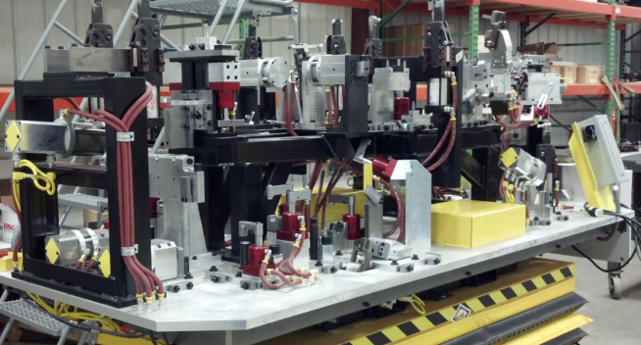
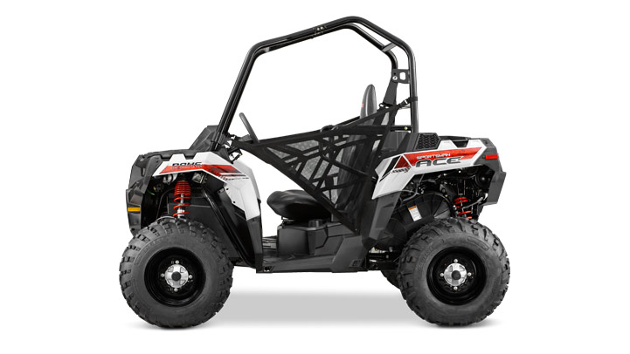
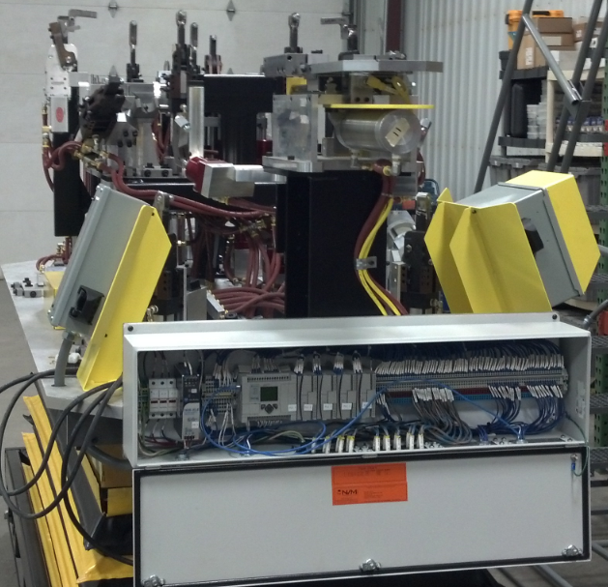
Weld Fixtures
Manual Frame Welding – PLC Controls
Sportsman ACE Vehicle Frame
Marriage fixture to hold multiple subweldments together for final welding.
PLC Controlled with Prox Switch Feedback on fixture positions.
Dual Operator Control

Slide 13
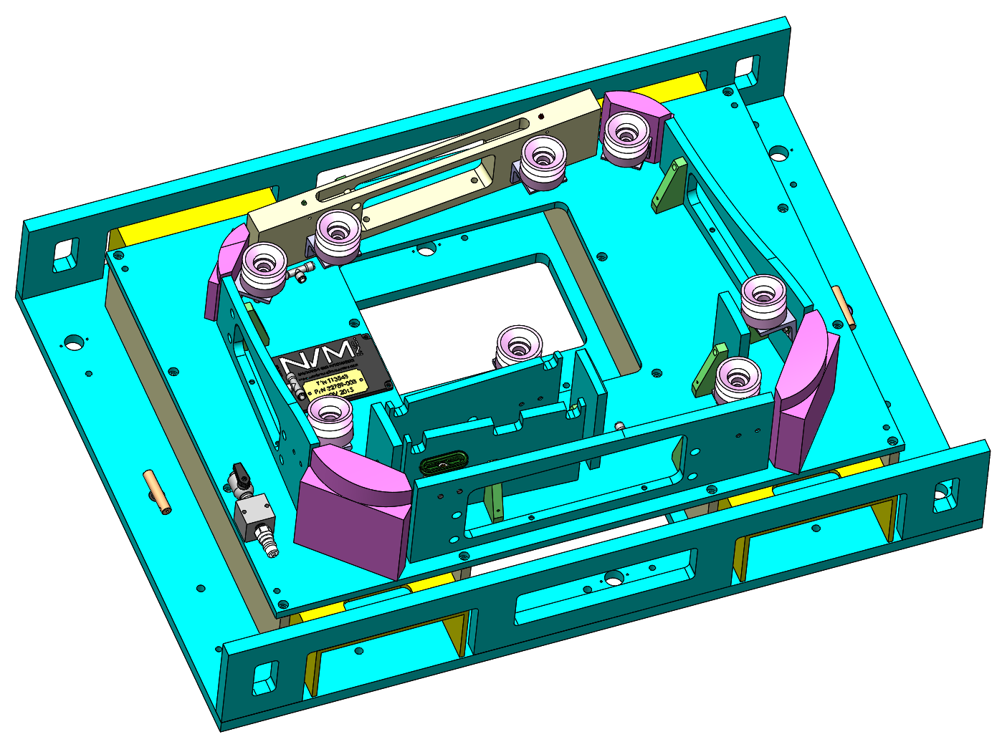
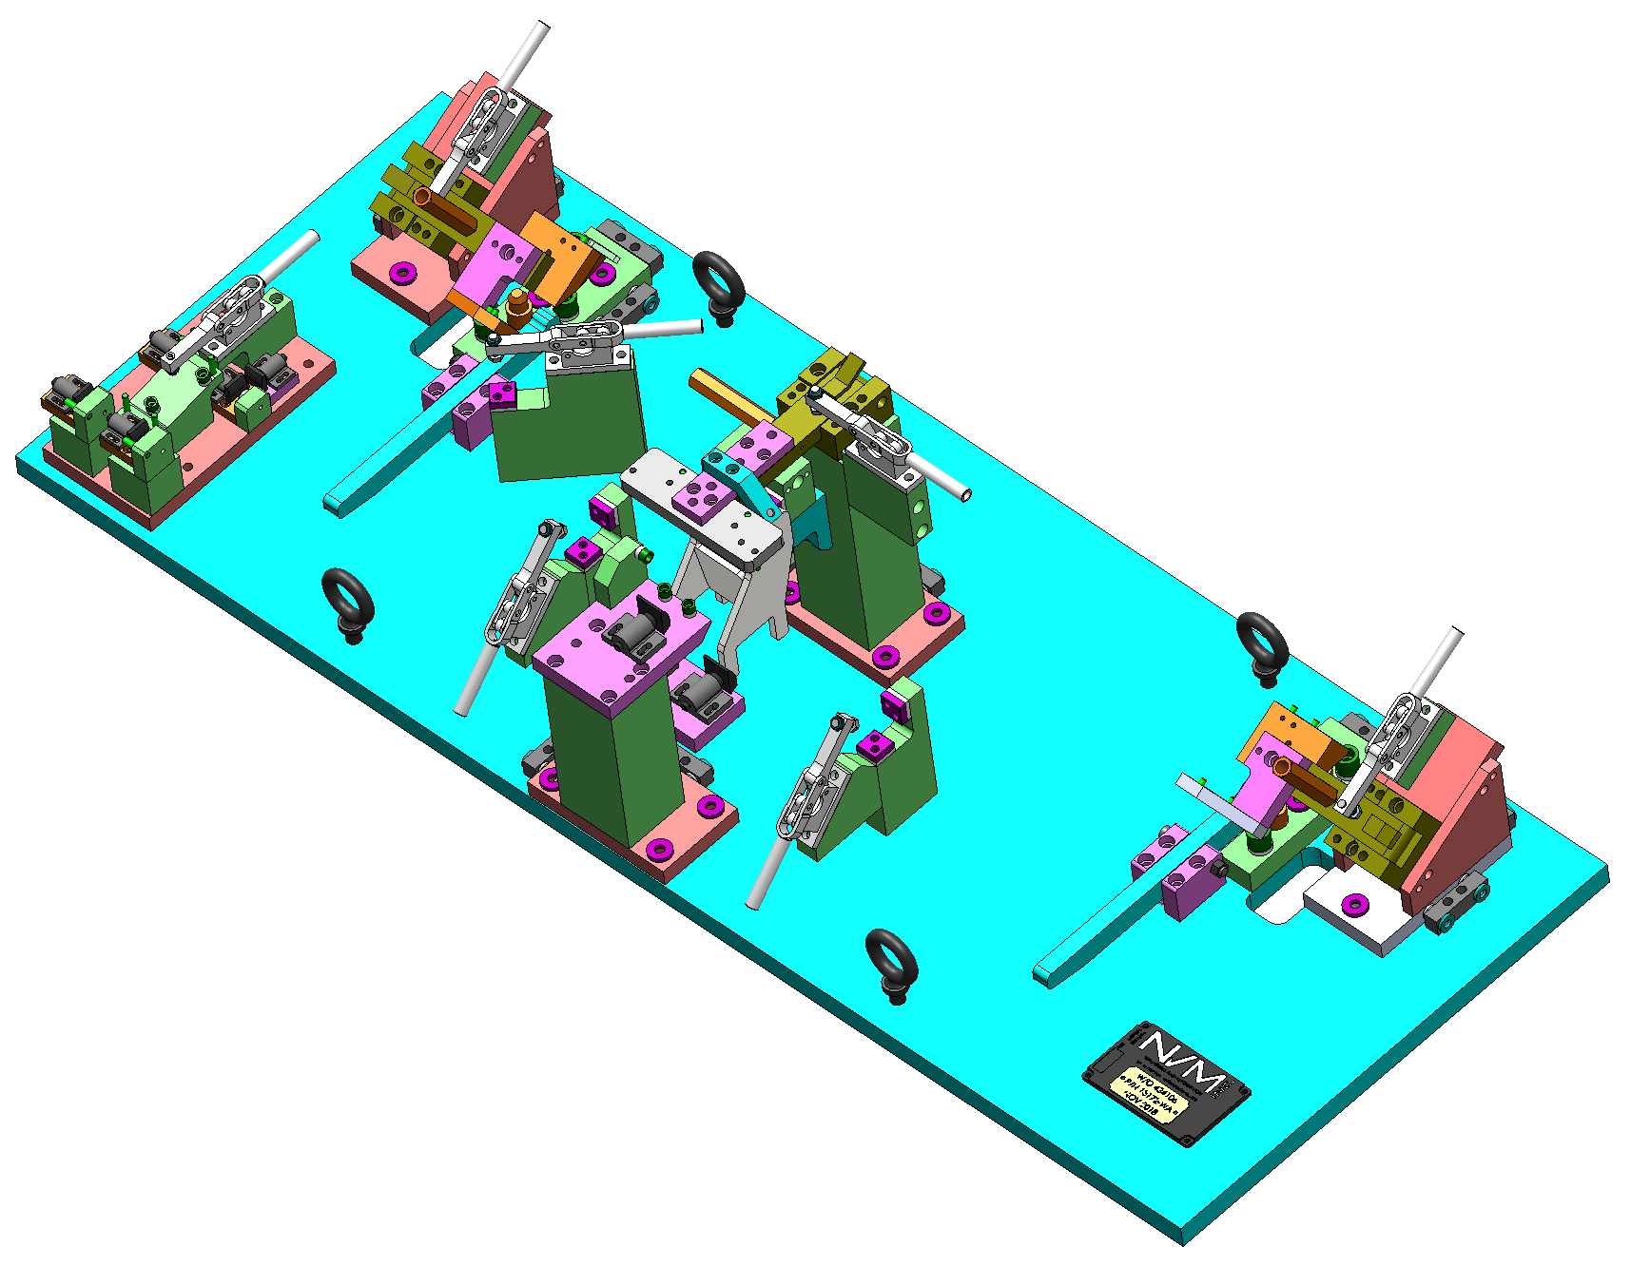
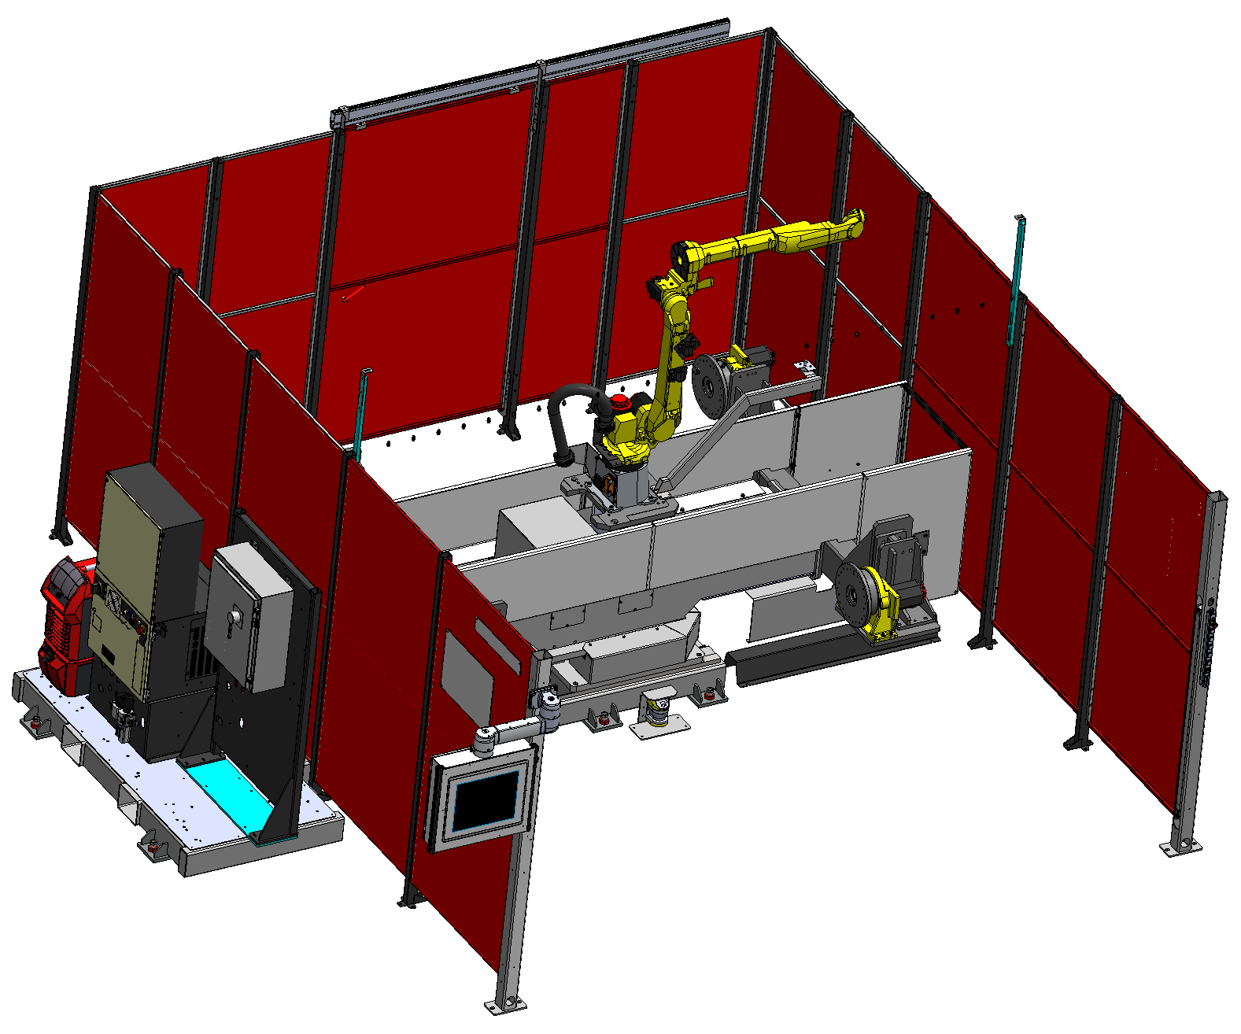
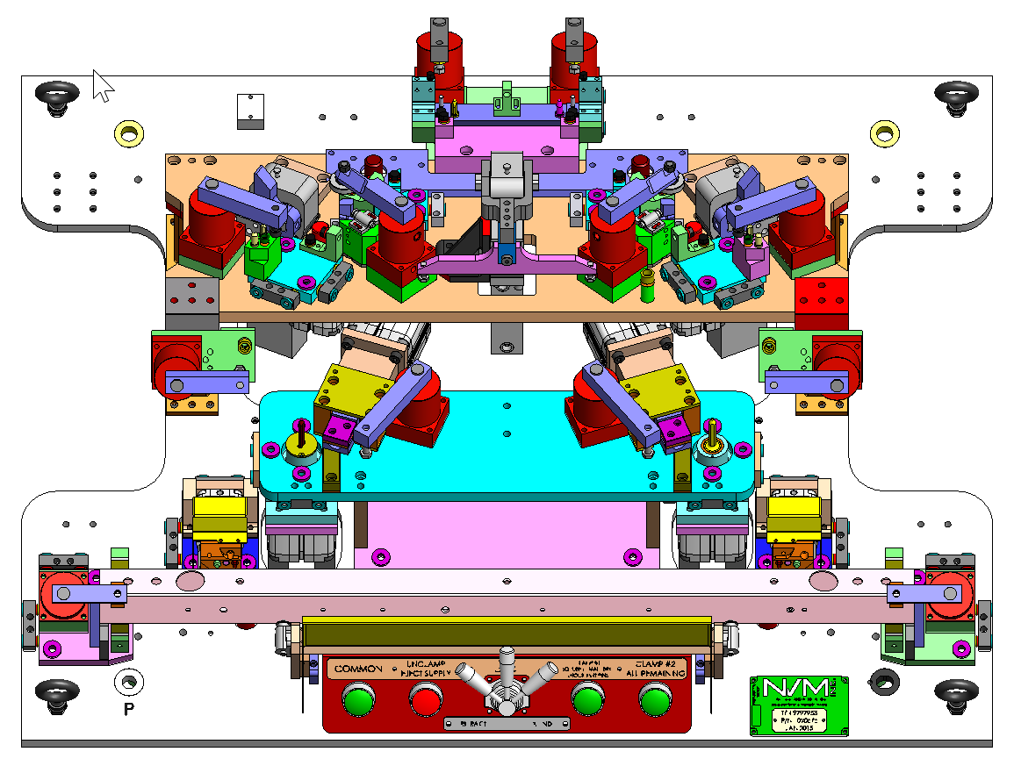
Modeling Software
Solidworks 3D Solid Modeling
Solidworks Electrical

Slide 14

Welding Automation
Fanuc / Lincoln Electric Robotic Integrator
Fanuc / Lincoln Robotic Integrators
  Turn Key Weld Cell Solutions
  Robotic Weld Cell Integration
  Weld Fixtures
  Quick Removal Picture Frames

Slide 15
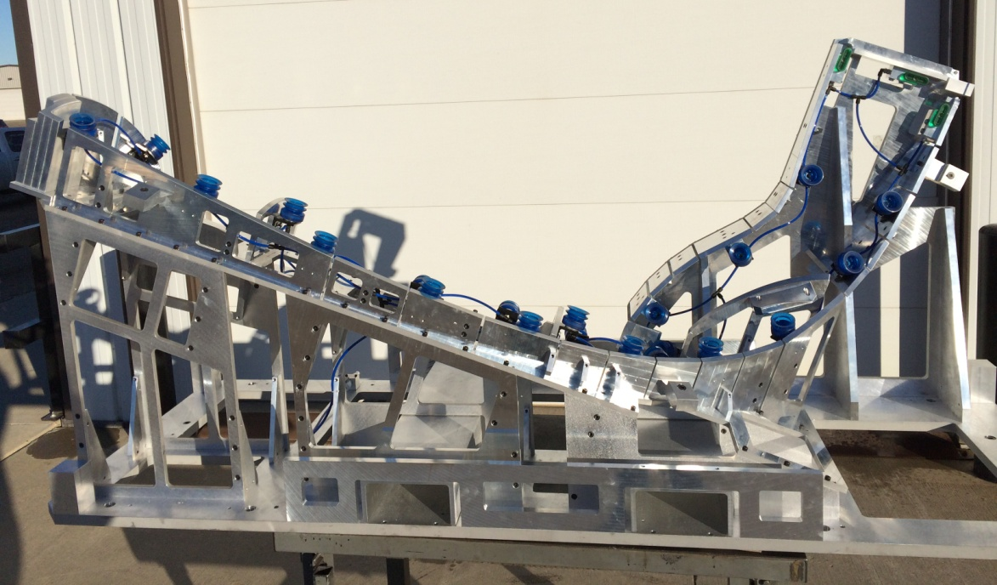
Holding Fixtures
Vacuum Holding Fixture for 5-Axis CNC Router

Slide 16
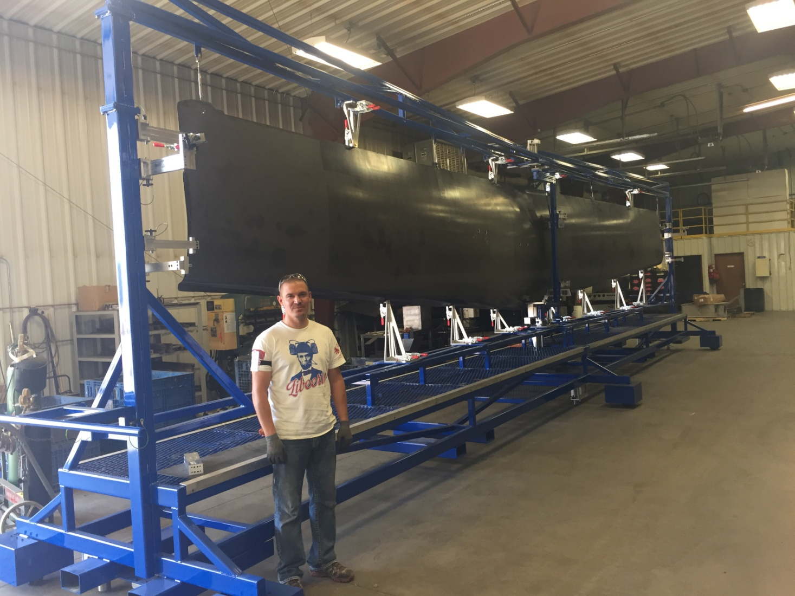
Inspection Fixtures
Fixture Details
42’ long x 11’ tall x 7’ wide
Interchangeable quick change details
Important details have shim-ability
Pins for locating fixture
Inspection fixture for Non Destructive Testing

Slide 17

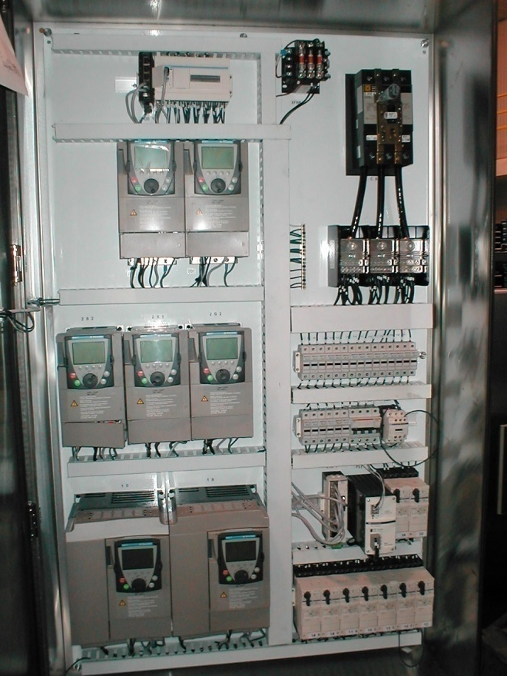
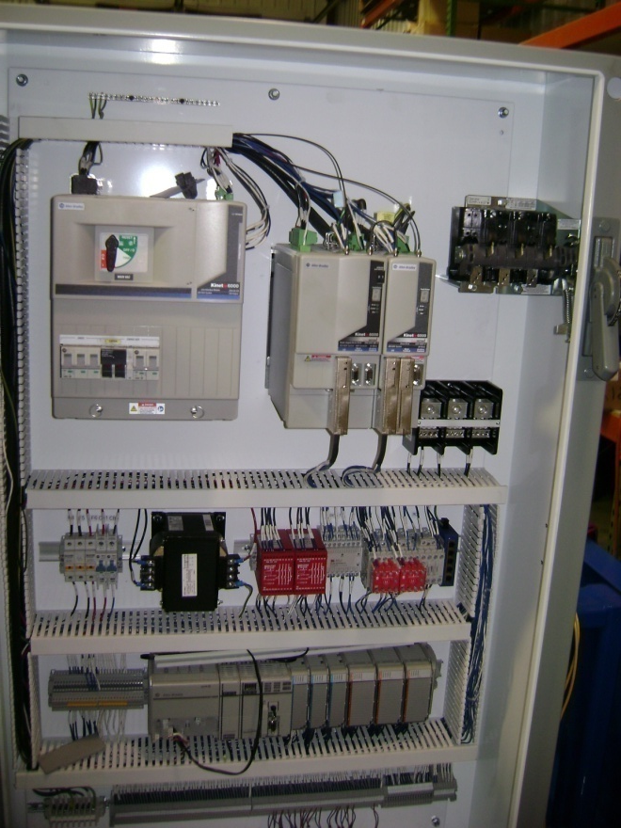
UL 508A Panel Shop
Schematics
Panel Layouts
PLC Programming
Field Wired to Terminal Blocks
Built to customer specifications
Prefer COTS parts
Panels are UL Listed

Slide 18
Documentation
Documentation is created and released in electronic format
3D Solid model
Schematics *
PLC Program
Operator Manual *
Maintenance Manual *
Bill of Material
Wear Parts Prints *
* Provided in Printed media in addition to the electronic format.

Slide 19
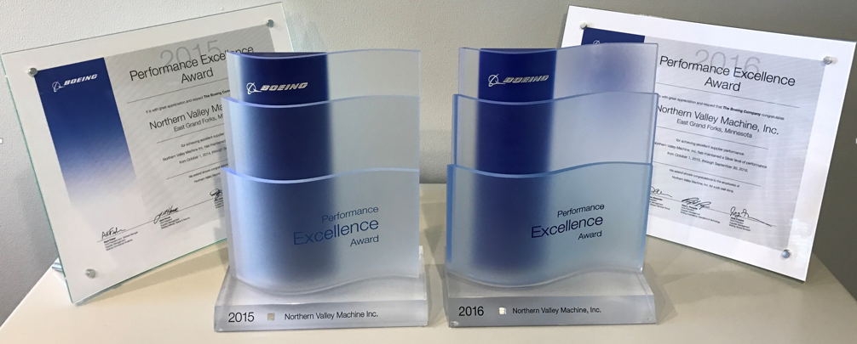
Why NVM?
Fast
One Shop Stop
  Design
    Mechanical Design
    Electrical Design
    Programming
  Machining
  Assembly
  Fabrication
  Inspection
Quality

